Slide 1
2$ RING
play!!!1111!!111!!1!!
tutorial11!!111!!!11!

Slide 2
EEEEEEEEEEEEEEE

Slide 3
Attack enemy!

Slide 5
BOSS

Slide 6

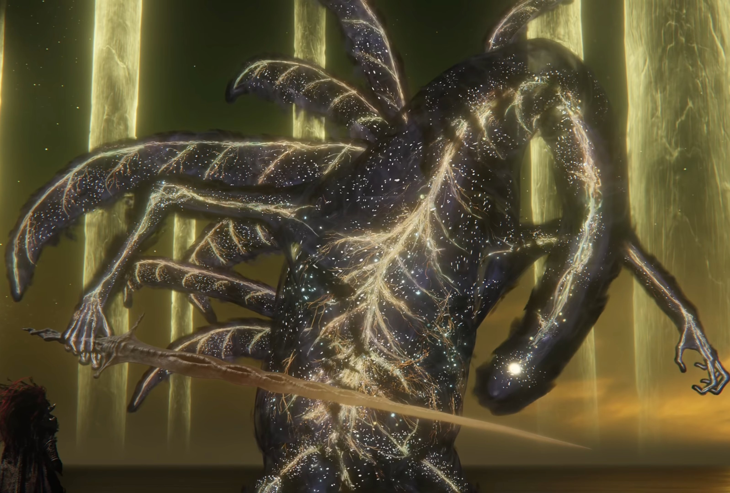
Attack enemy!

Slide 7
!

Slide 8
YAY! YOU WIN!!!!!!!!!!!!!!!!!!!!!!!!!!
Back to main menu

Slide 9
Welcome to the tutorial!!!!!

Slide 10
Im not making a tutorial

